Slide 1



GOODNESS OF FIT

Slide 2
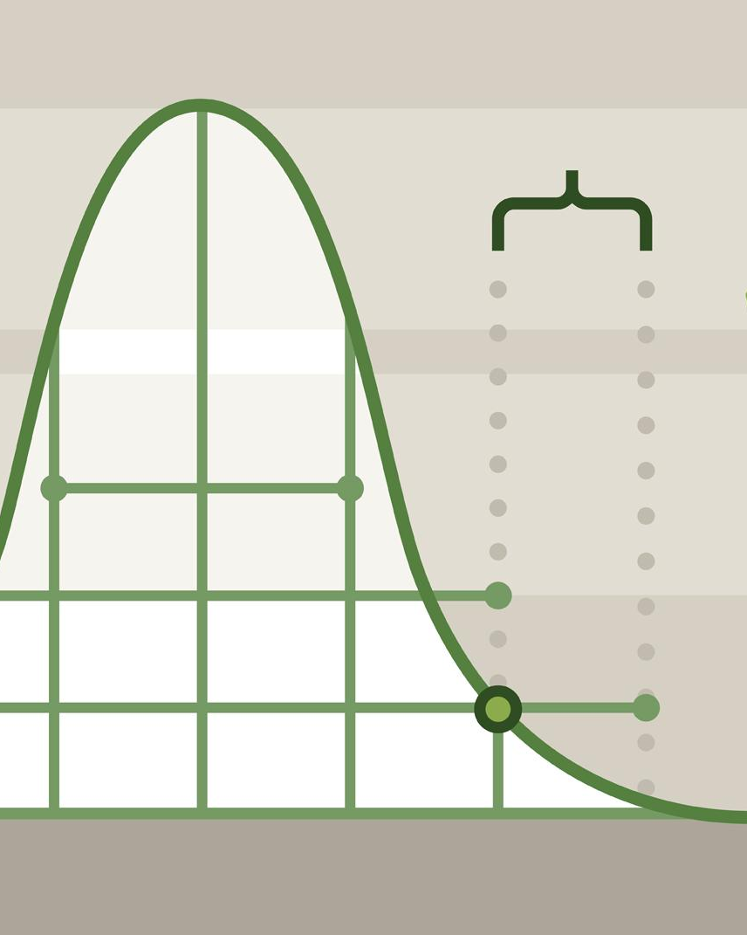
HYPOTHESIS TESTING
For a given observed sample X, we check how unlikely it is to produce X in a world where our null hypothesis is true (p-value). If our observation is overwhelmingly unlikely (p<𝛂), we prefer to reject the notion that we are living in a world where the null is true.
On the other hand, if our observation X is not that unlikely in a world where the null holds, we do not reject the null.
Welcome

Slide 3
GOODNESS OF FIT - FIT TO DISTRIBUTION
Suppose you have some phenomenon that you repeat and you count the frequency of its outcomes, i.e., the number of times each different event happens.
E.g.
The number of times you get 0,1,2,3,... passengers missing an airflight
The number of times you open 1,2,3,... cans of tuna until you find one that is rotten
The number of times 0,1,2,3,... goals are scored in the last 10 minutes of a football match
The number of times people buy cola, pepsi, water out of 100 sales
Obs 1: Some of these, we have seen, follow a particular distribution (binomial, geometric, poisson...)
Obs 2: Notice you can only do this for discrete (or if you prefer categorical) observations

Slide 4
GOODNESS OF FIT - FIT TO DISTRIBUTION
If we don’t have a strong theoretical reason to claim that a certain phenomenon follows a particular distribution and we suspect it does, can we show that using data? After all, if we can assume something follows a particular well-studied distribution, we get a lot of results and stats packages that are directly applicable to our phenomenon.
We will test if a certain set of observations can reasonably be said to come from a specific distribution by using a Goodness-of-Fit test.
The guiding principle is the following: If our phenomenon does follow a certain distribution, we would expect it’s outcomes to follow certain patterns. If our observed data does not stray too far from these patterns (i.e. if it is a “good fit” to the patterns), we can assume it comes from the posited distribution.

Slide 5
GOODNESS OF FIT - FIT TO DISTRIBUTION
Based on the data from all vending machines, Unilever believes that 40% of sales from their machines are Coca-cola, 30% are Pepsi and the remaining 30% are water. They have a stocking system quite optimized for these ratios, but we know not all vending locations necessarily follow this distribution.
We have one machine and we noticed that from the last 300 sold bottles we sold the following:
Do we have evidence here to disprove that our machine follows Unilever’s posited distribution for vending machines? Should we develop our own stocking system or can we import the one created by Unilever?
We will use the hypothesis testing logic: we assume that the machine follows Unilever’s distribution and see if observed reality strains the credibility of that assumption at a significance level of, say 5%
 | Sold
Coca-cola | 120
Pepsi | 80
Water | 100

Slide 6
GOODNESS OF FIT - FIT TO DISTRIBUTION
H₀ : Dist_{machine}~(40%,30%,30%) vs H₁ : Dist_{machine}≁(40%,30%,30%)
We first build a table of expected observations under H₀
Expected sales under H₀
Observed sales from sample
 | Dist | Expected
Coca-cola | 40% | 40%*300 = 120
Pepsi | 30% | 30%*300 = 90
Water | 30% | 30%*300 = 90
 | Sold
Coca-cola | 120
Pepsi | 80
Water | 100

Slide 7
GOODNESS OF FIT - FIT TO DISTRIBUTION
If the null hypothesis was true, we would think that the observed data in each category would be close in value to the expected numbers in each category. In such circumstances the data provides a close fit to the assumed population distribution of probabilities.
A test of the null hypothesis is based on an assessment of the closeness of this fit and is generally referred to as a goodness-of-fit test. Now, in order to test the null hypothesis, it is natural to look at the magnitudes of the discrepancies between what is observed and what is expected. The larger these discrepancies are in absolute value, the more suspicious we are of the null hypothesis.

Slide 8
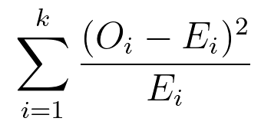
GOODNESS OF FIT - FIT TO DISTRIBUTION
The test statistic for this problem is
Where O_{i} is the number of actual observations in category i and E_{i} is the expected number of observations in that category. In our Unilever case
i | E_{i} | O_{i}
Coca-cola | 120 | 120
Pepsi | 90 | 80
Water | 90 | 100
(O_{i}-E_{i})² | (O_{i}-E_{i})²/E_{i}
0 | 0
100 | 1.11
100 | 1.11
And our statistic is
0 + 1.11 + 1.11 = 2.22
Is this number big or small?
This is not a t-stat nor a z-stat

Slide 9
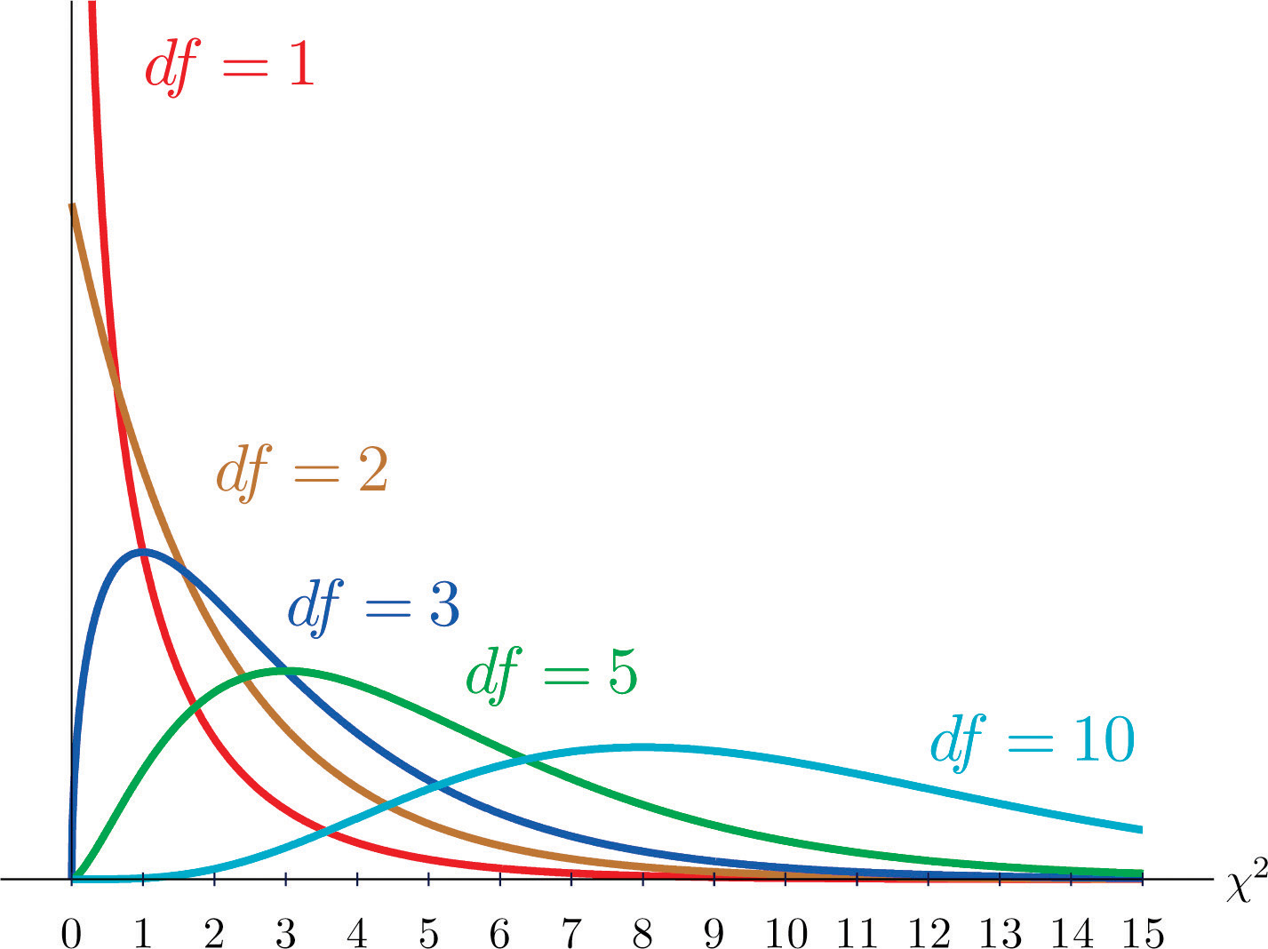
GOODNESS OF FIT - FIT TO DISTRIBUTION
This statistic follows a Chi-squared distribution. Just like T-distributions, there is no single Chi-squared. Instead there is one for each 𝕟 (called degrees of freedom), but now 𝕟 does not stand for the number of observations -1. Instead it stands for the number of categories -1. In this case, our 𝕟=3-1=2
We can get a p value with the function
import scipy.stats as st
st.chi2.sf(abs(stat),n)
Or all of this can be abstracted away in the function
st.chisquare([120,80,100], f_exp=[120,90,90])
In this case there are no considerations on one-tailed versus 2-tailed 😁

Slide 10
TO JUPYTER

Slide 11
GOODNESS OF FIT AND ASSOCIATION TESTING
Suppose that a sample is taken from a population and the members can be uniquely classified according to a pair of discrete characteristics A and B. The hypothesis to be tested is of no association in the population between possession of characteristic A and possession of characteristic B. For example, a travel agency may want to know if there is any relationship between a client’s gender and the method used to make an airline reservation.
Essentially we will posit as null hypothesis that the presence of an aspect of characteristic A (say gender being male) does not influence the distribution of characteristic B (method of reservation), or vice versa.

Slide 12
GOODNESS OF FIT AND ASSOCIATION TESTING
Let’s take an example of market differentiation. Makers of products want their products to be distinctly perceived from the competition so let’s say 3 car makers want to understand how their brand is perceived and if they are sufficiently differentiated. A survey of 513 car owners where they are asked to identify 3 brands with the notions of “Sportive” or “Safe” returns the following results
Brand | Sportive | Safe | Total
BMW | 256 | 74 | 330
Mercedes | 41 | 42 | 83
Lexus | 66 | 34 | 100
Total | 363 | 150 | 513

Slide 13
GOODNESS OF FIT AND ASSOCIATION TESTING
The null hypothesis would be that the brand does not influence perception. To compute the expected observations for each box, we first ignore the actual granular values and find the marginal proportions
Brand | Sportive | Safe | Total
BMW |  |  | 330
Mercedes |  |  | 83
Lexus |  |  | 100
Total | 363 | 150 | 513
330/513=64.3%
Brand | Sportive | Safe | Total
BMW |  |  | 64.3%
Mercedes |  |  | 16.2%
Lexus |  |  | 19.4%
Total | 70.7% | 29.2% | 100%

Slide 14
GOODNESS OF FIT AND ASSOCIATION TESTING
Now we find the individual proportions for each pair under the null hypothesis. This assumes each car is rated on each characteristic independently, so the proportions do not change when you compare car brand or characteristic descriptive
Brand | Sportive | Safe | Total
BMW | 70.7%*64.3% |  | 64.3%
Mercedes |  |  | 16.2%
Lexus |  |  | 19.4%
Total | 70.7% | 29.2% | 100%
Brand | Sportive | Safe | Total
BMW | 45.5% | 18.8% | 64.3%
Mercedes | 11.5% | 4.7% | 16.2%
Lexus | 13.7% | 5.7% | 19.4%
Total | 70.7% | 29.2% | 100%

Slide 15
GOODNESS OF FIT AND ASSOCIATION TESTING
We now get back to our expected values by remembering that we had 513 cars
513*45.5%
Brand | Sportive | Safe | Total
BMW | 45.5% | 18.8% | 64.3%
Mercedes | 11.5% | 4.7% | 16.2%
Lexus | 13.7% | 5.7% | 19.4%
Total | 70.7% | 29.2% | 100%
Brand | Sportive | Safe | Total
BMW | 233.4 | 96.4 | 330
Mercedes | 59.0 | 24.1 | 83
Lexus | 70.3 | 29.2 | 100
Total | 363 | 150 | 513

Slide 16
GOODNESS OF FIT AND ASSOCIATION TESTING
Now we have our Observed table and our Expected table under H₀
Observed Table
Expected Table (under H₀)
Brand | Sportive | Safe | Total
BMW | 256 | 74 | 330
Mercedes | 41 | 42 | 83
Lexus | 66 | 34 | 100
Total | 363 | 150 | 513
Brand | Sportive | Safe | Total
BMW | 233.4 | 96.4 | 330
Mercedes | 59.0 | 24.1 | 83
Lexus | 70.3 | 29.2 | 100
Total | 363 | 150 | 513

Slide 17
GOODNESS OF FIT - FIT TO DISTRIBUTION
The test statistic for this problem is still
Where O_{i} is the number of actual observations in category i and E_{i} is the expected number of observations in that category. Notice that we now have 6 categories (3 car brands * 2 characteristics)
Brand | Sport | Safe
BMW | 256 | 74
Merc | 41 | 42
Lexus | 66 | 34
(256-233.4)²/233.4
= 2.19
Brand | Sport | Safe
BMW | 2.19
Merc
Lexus
Brand | Sport | Safe
BMW | 233.4 | 96.4
Merc | 59.0 | 24.1
Lexus | 70.3 | 29.2

Slide 18
GOODNESS OF FIT - FIT TO DISTRIBUTION
This statistic still follows a Chi-squared distribution. But in these tests, 𝕟 (called degrees of freedom) is the number of rows -1, multiplied by the number of columns-1
In this case, our 𝕟=(3-1)*(2-1)=2*1=2
We can run the function
import scipy.stats as st
st.chi2.sf(abs(stat),n)
To automatically get the p-value
In this case there are no considerations on one-tailed versus 2-tailed 😁

Slide 19
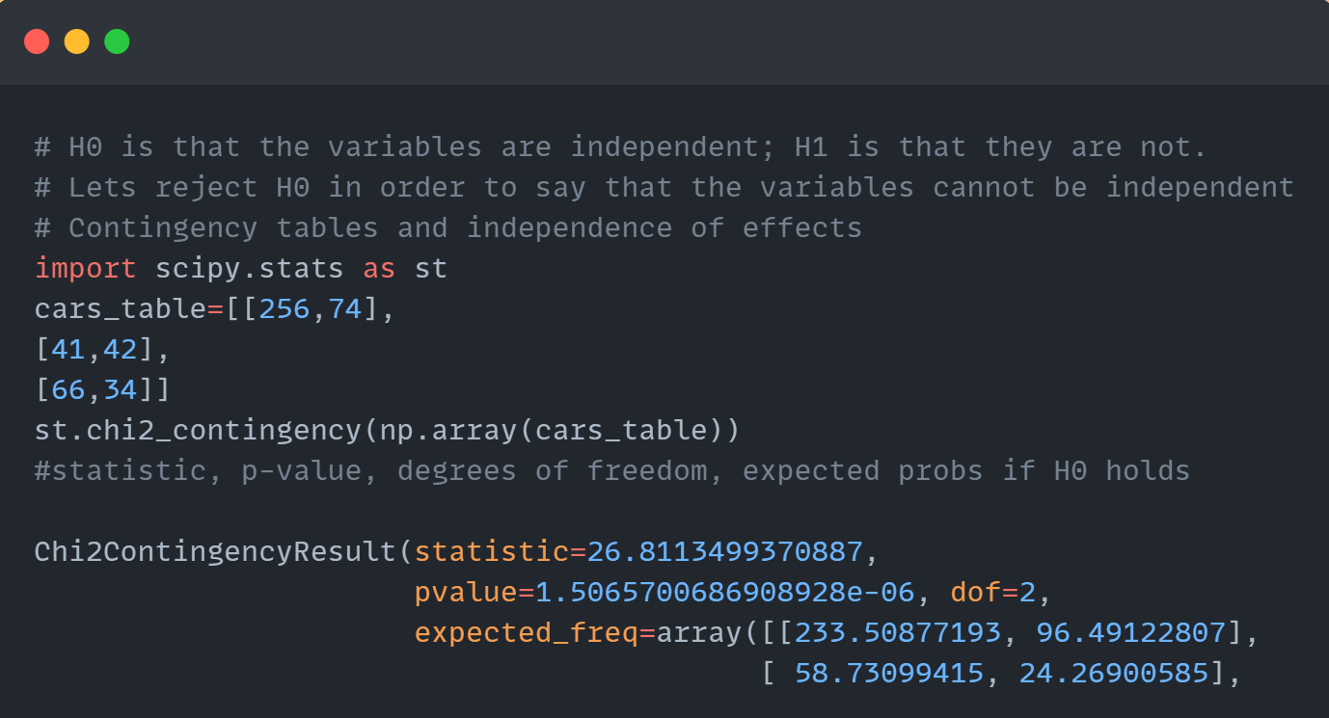
GOODNESS OF FIT - FIT TO DISTRIBUTION
Notes:
Python Code: import scipy.stats as st
cars_table=[[256,74],
[41,42],
[66,34]]
st.chi2_contingency(np.array(cars_table))

